Slide 1
Game of Thrones
(Network Analysis)
Ganesh Nagarajan
Parmeet Singh Ahluwalia
Sanjana Pukalay

Slide 2
Why should we care?
Highly rated and popular television show
Numerous characters and interconnected storylines
Network Analysis - Interesting problem

Slide 3
Existing work
‘Network of Thrones’ - Andrew Beveridge, Jie Shan
Published by Mathematical Association of America
Discusses network graph using character interactions, character statistics, connections statistics like in-degree, out-degree etc.

Slide 4
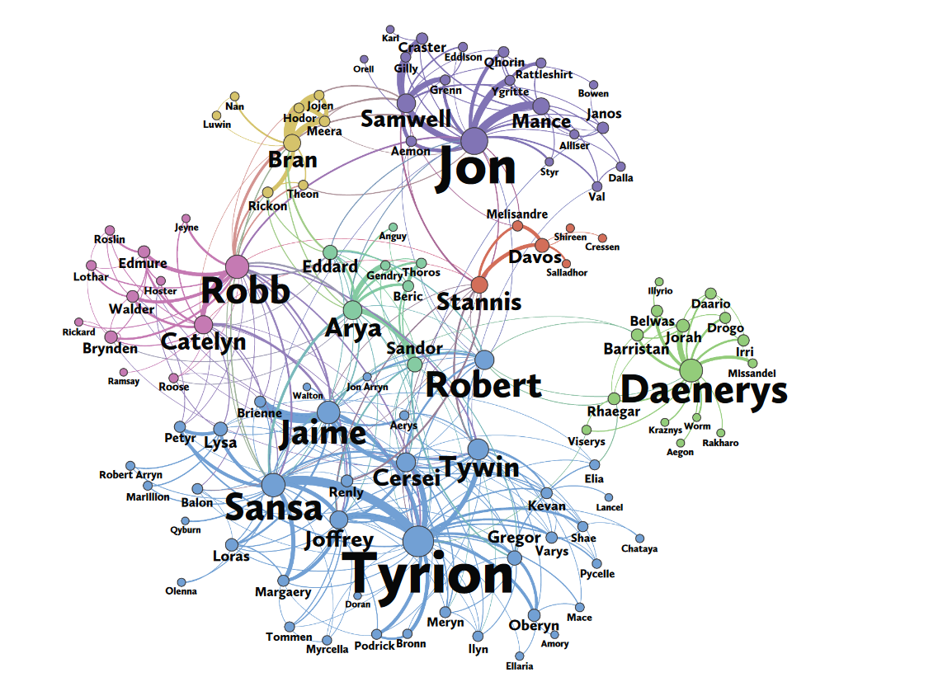
Existing Work (Contd)
Size of Vertex -> Pagerank Value
Edge thickness -> weight
Size of label -> Betweenness centrality

Slide 5
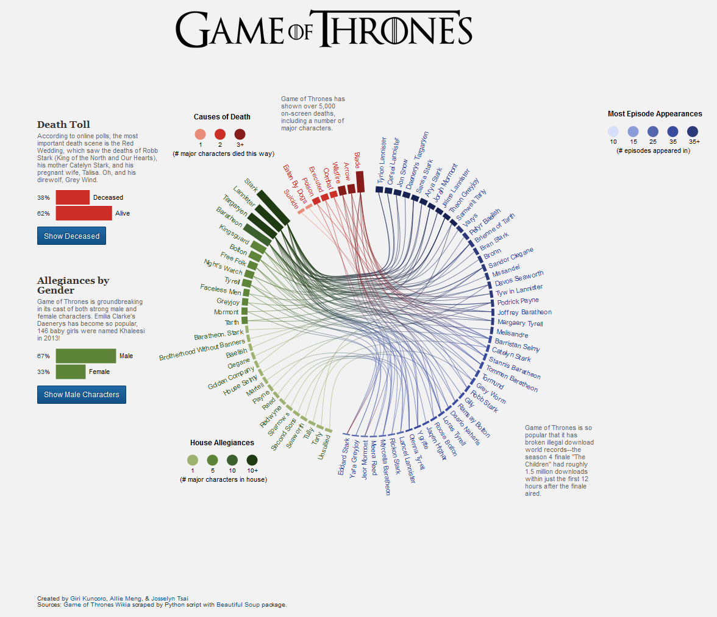
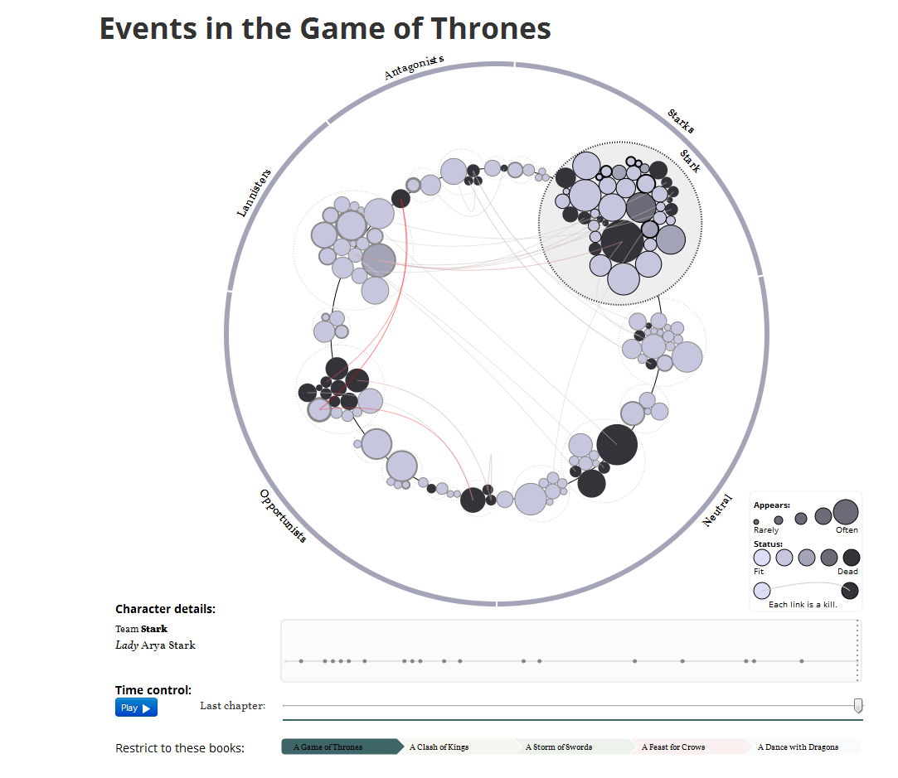
Existing Work (Contd)
[1] http://thronesviz.github.io/, Created by Giri Kuncoro, Allie Meng, & Josselyn Tsai
[2] http://www.jeromecukier.net/projects/agot/events.html by Jerome Cukier

Slide 6
Research Question
Network Visualization showing all the characters along with their relationships, Houses and Allegiances seen in the series to determine:
● Who are the top 5 most popular characters in terms of connections?
● How are parameters like House Allegiances, Belief systems and Religion related?
● What kind of inferences can be drawn when the data is visualised graphically?

Slide 7
Methodology
Data Collection
Data Extraction
Data Cleaning
Data Processing
Data Visualization

Slide 8
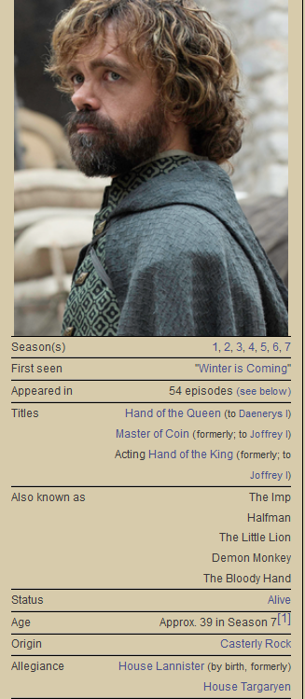
Methodology
Data Collection
Data: Crawled the ‘Game of Thrones Wikia’ page;
Exported data in XML.
Dataset Statistics: 7602 Relations; 2236 Nodes
Data Extraction
Extracted Character Names, Entities and associated
relationships from XML data using Python
[1] http://gameofthrones.wikia.com/wiki/Tyrion_Lannister

Slide 9
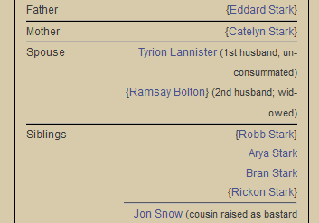
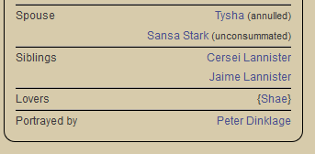
Methodology
Data Cleaning
Eliminated duplicate value and noise caused by two-way association of relationships using Python
[1] http://gameofthrones.wikia.com/wiki/Sansa_Stark
[2] http://gameofthrones.wikia.com/wiki/Tyrion_Lannister

Slide 10
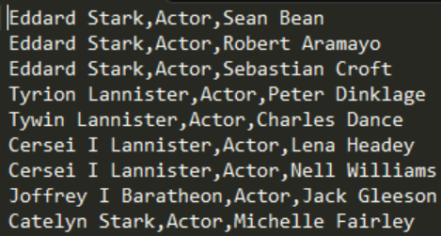
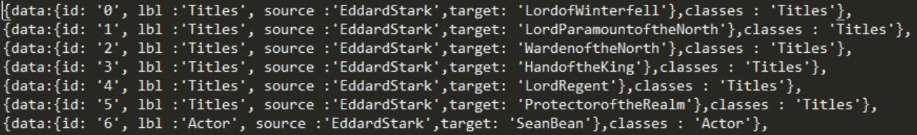
Data Processing
Changed the data into required format in order to communicate with the frontend and JSON formats using Python.

Slide 11
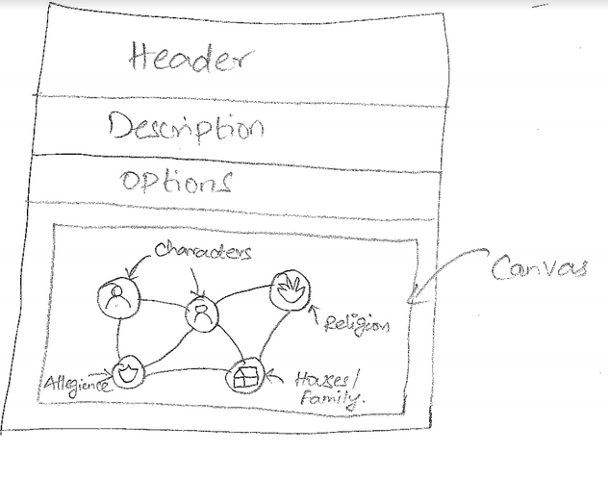
Methodology
Data Visualization
Created Heterogeneous Graph - People, Places, Relationships, Title.

Slide 12
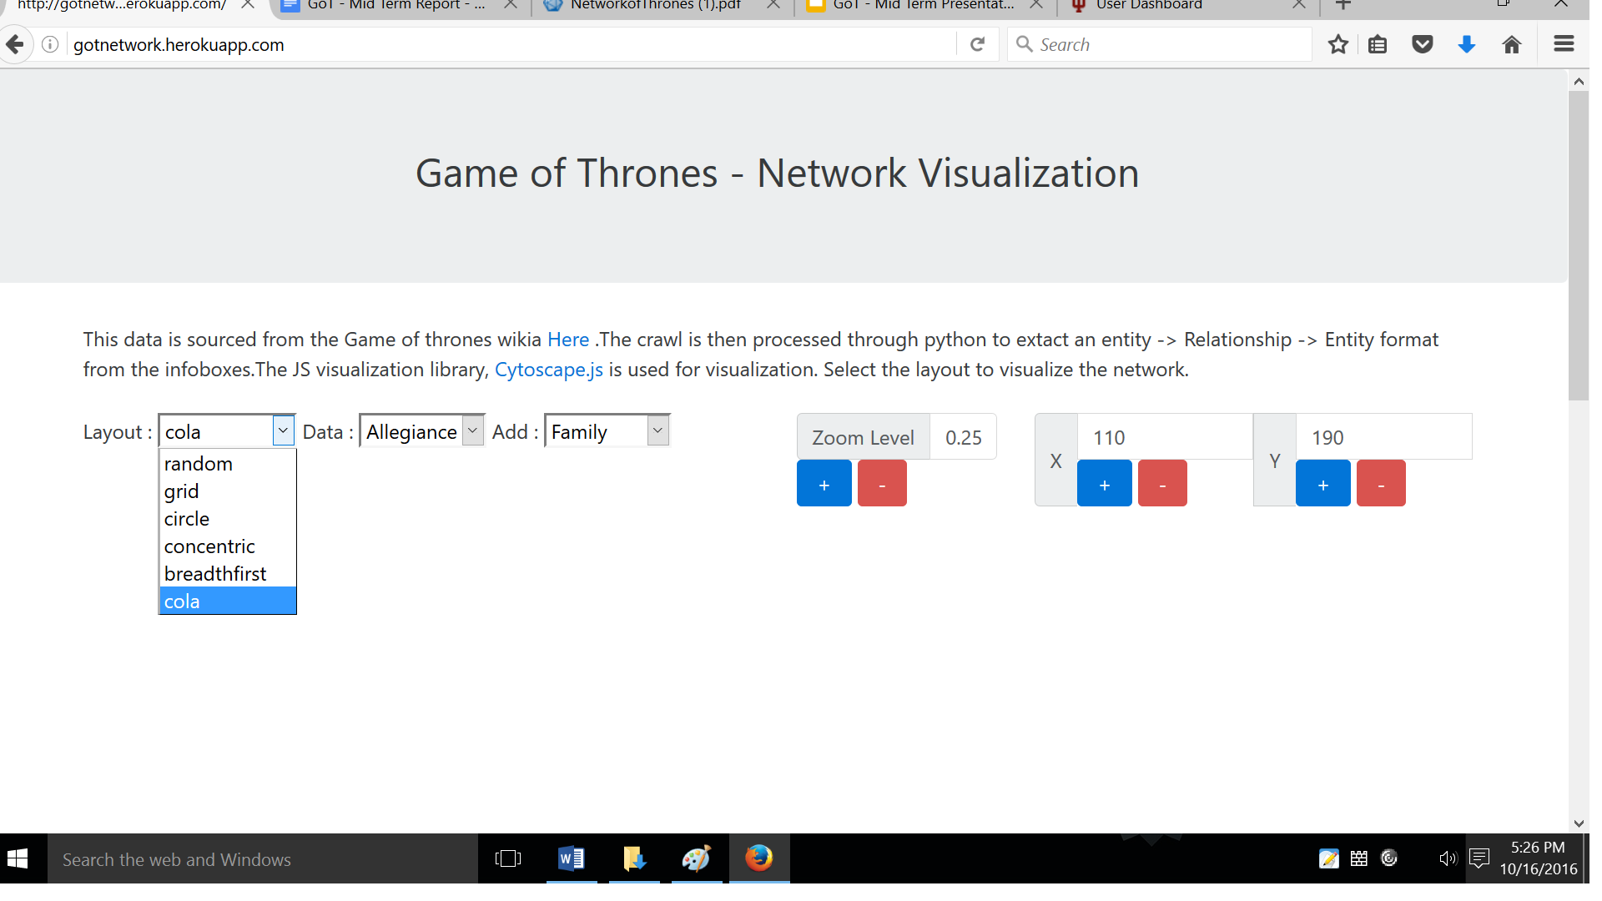
Visualization: Various Views

Slide 13
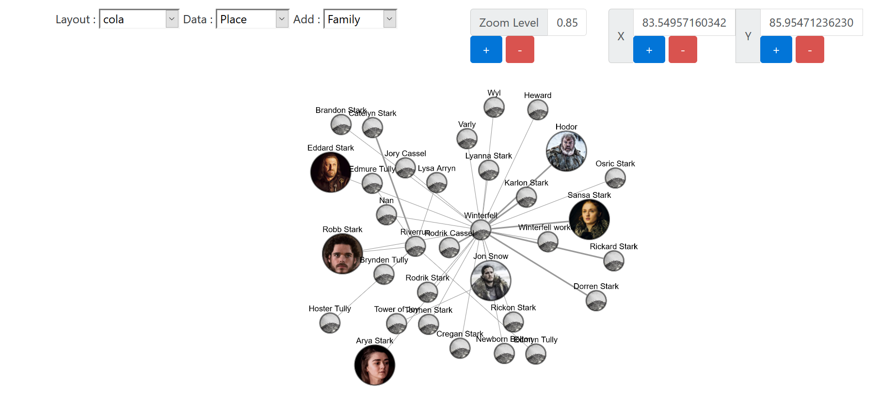

Slide 14
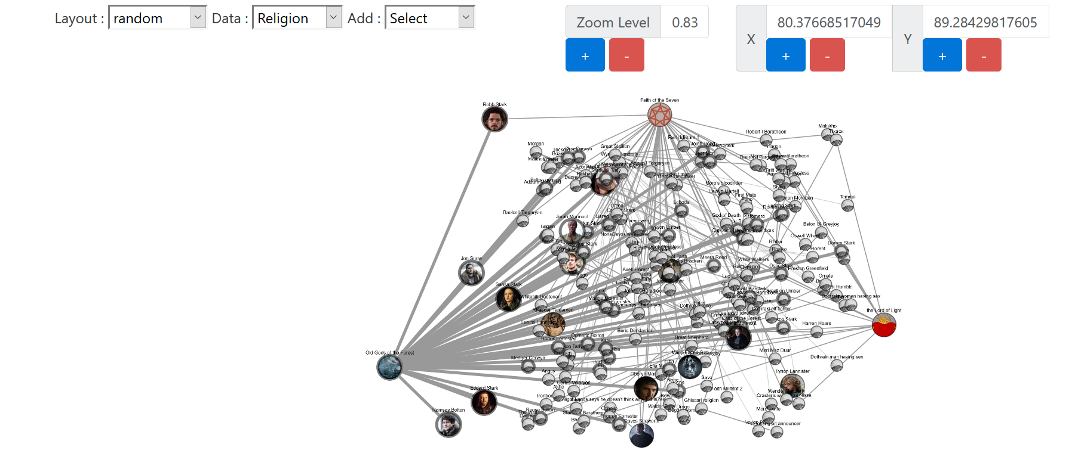

Slide 15
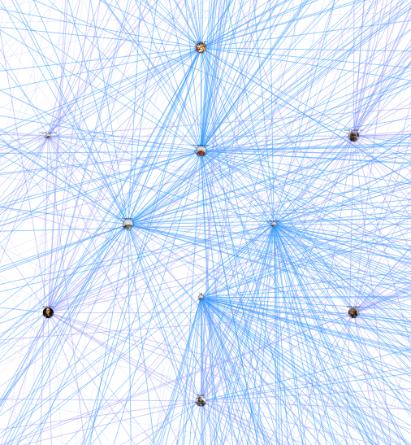
Insights
Night’s Watch !!!
(surprise)
After visualizing the network and seeing the various ways in which every character is related, it was startling to see some allegiances which were not apparent on the show.
This was because of the data that was extracted from the wikipedia page.
Difference in certain beliefs. Eg: Robb Stark was connected to the Faith of the Seven in the previous visualization.
Targaryen
Starks

Slide 16

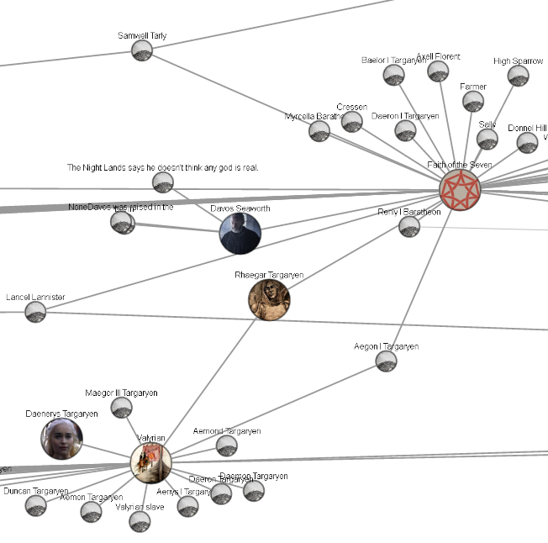
Insights[Contd]
By making it a network between all the characters, we could easily show which characters are strongly connected and which are not.
Certain important characters could actually be recognized using this method. Eg: Jon Snow.
New Insights and Engagement
[1] https://www.reddit.com/r/freefolk/comments/4q3ccm/davos_if_he_commands_you_to_burn_children_your/

Slide 17
Future Work
Clustering
Community Detection
More Architectural Changes:
Using a graph database as a backend instead of JS

Slide 18
Demonstration
http://gotnetwork.herokuapp.com/

Slide 19
Questions ?

Slide 20
Thank you!

